Slide 1
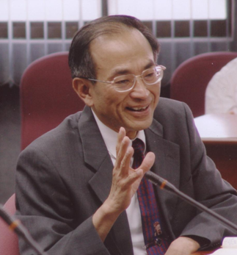
Seminar
on
Chinese Intellectual History
10. Buddhism (I): Hua Yan
Chun-chieh Huang
National Chair Professor
National Taiwan University
Research Fellow, Academia Sinica
Email: cc10.huang@msa.hinet.net
http://huang.cc.ntu.edu.tw

Slide 2
I.
Lecture Notes:

Slide 3
1. The Historical Background:
Tang (618-907)
An age of Pax Sinica
An age of gifted poets, beautiful ladies
"Shavelings" (Buddhist monks) and the Daoist
priests walked in the street of Changan 長安.

Slide 4
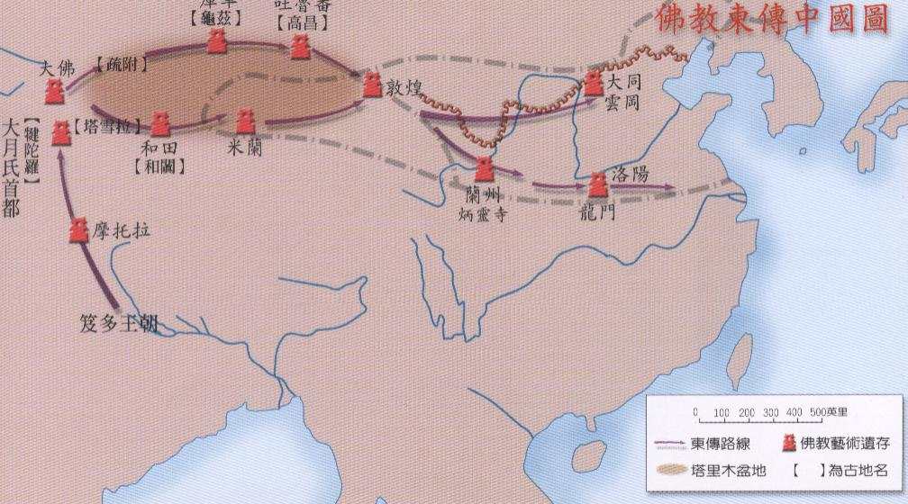
Eastward progression of Buddhism

Slide 5
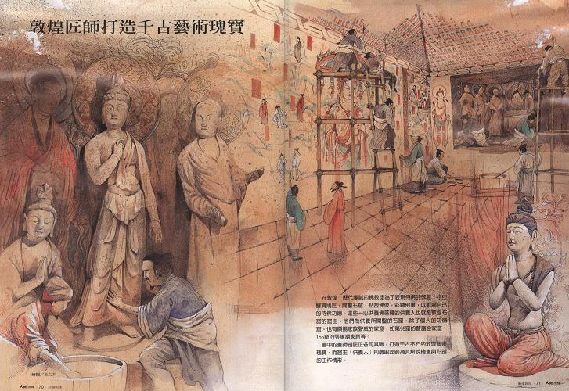
Dunhuang

Slide 6
1:1. Eclecticism:
1) Intellectual and Religious Arena:
a. Buddhism
b. Confucianism:
Kong Yingda 孔穎達 ed., The Correct
Meanings of the Five Classics (五經正義).

Slide 7
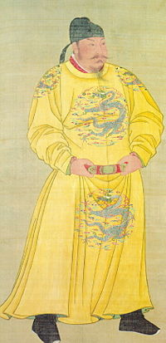
2) Institutionally:
a. Civil-service examination system:
Emperor Tai of the Tang 唐太宗
(reign 626-649)
"All the heroes in the world
fall into my arrow shot."

Slide 8
b. Central government:
Prime Ministership:
Secretariat of State Affairs (尚書) —
responsible for implementation
Imperial Secretariat (中書) —
designation of policies–making
Imperial Chancellery (門下) —
Sanction or Veto
① Division of Labour:
Six Boards: Personnel, Revenue, Rites,
War, Justice, Public works.
② Autonomy of prime ministership
③ Specialization and professionalism

Slide 9
c. Local government:
province (circuits)
prefectures
subprefectures

Slide 10
1:2. Cosmopolitianism:
1) Changan
2) Religions: Zoroastrianism, Nestorian
Christianity, Judaism, Islam.

Slide 11
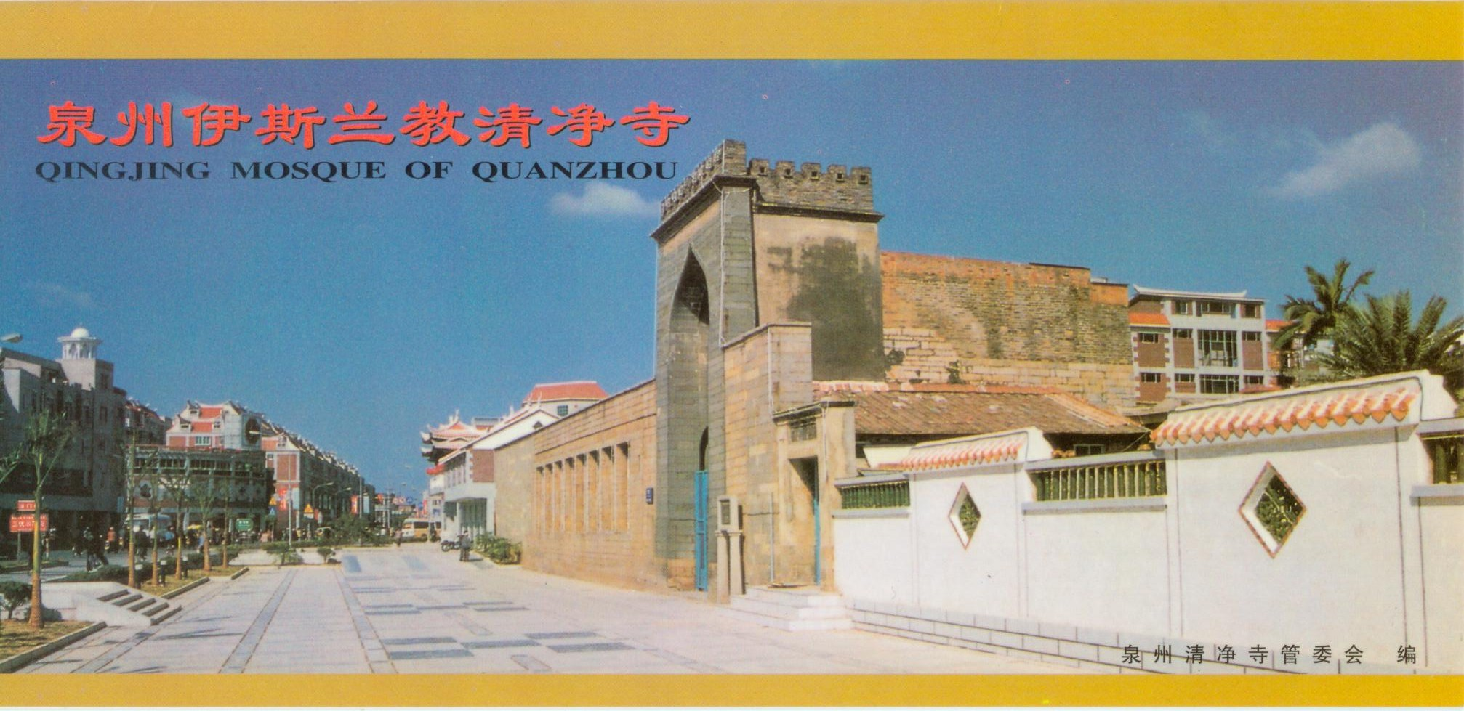
Qingjing Mosque of Quanzhou

Slide 12
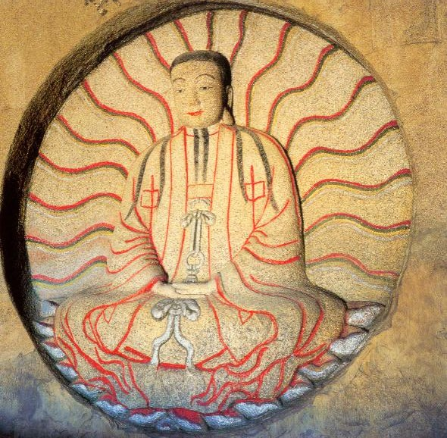
Relics of Nesorian Churches
Buddha of Manichaeism

Slide 13
2. The Philosophy of Buddhism
2:1 Salient Features of Buddhism:
Founder: Buddha
Sākyamuni (Siddhartha Gautama, 566? – 486? B.C.)

Slide 14
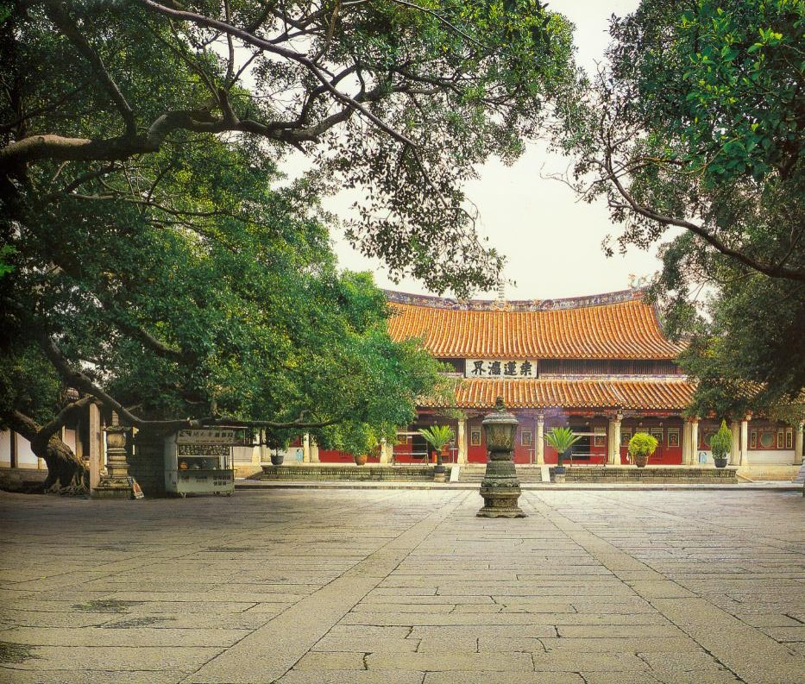
Kaiyuan Temple and its Great Hall’s ornament

Slide 15
1) Six striking facts about the religion Buddha
preached:
a. devoid of authority
b. devoid of ritual
c. skirting speculation
d. devoid of tradition
e. requiring intense self-effort
f. devoid of the supernatural

Slide 16
2) Original Buddhism can be characterized in the following terms:
a. It was empirical.
b. It was scientific.
c. It was pragmatic.
d. It was therapeutic.
e. It was psychological.
f. It was egalitarian.
g. It was directed to individual.

Slide 17
2:2 Buddhist View of Life and the World:
Four Noble Truths:
1) the Truth of Suffering (Duhkha, 苦)
Samsara: the cycle of unenlightened existence in which one is endlessly propelled by negative emotions and karma from one state of rebirth to another. The root of samsara is ignorance.
“In the Buddhist approach, life and death are seen as one whole.” (Sogyal Rinpoche , The Tibetan Book of Living and Dying)

Slide 18
2:2 Buddhist View of Life and the World: Four Noble Truths:
1) the Truth of Suffering (Duhkha, 苦)
b. Intentionality of life
∴ Happiness is the temporary relief or removal of suffering.

Slide 19
1) the Truth of Suffering (Duhkha, 苦)
c. Six moments when life’s dislocation
becomes apparen
The trauma of birth (生)
The morbidity of decrepitude (老)
The pathology of sickness (病)
The phobia of death (死)
To be tied to what one dislikes (怨憎會)
To be separated from what one loves (愛別離)

Slide 20
1) the Truth of Suffering (Duhkha, 苦)
d). Three Realms of Suffering:
consciousness
(1) the Desire Realm
(2) the Form Realm
(3) the Formless Realm

Slide 21
the Truth of Suffering (Duhkha, 苦)
e). Three Types of Suffering:
(1) the Suffering of Suffering
(2) the Suffering of Change
(3) the Suffering of Conditioning

Slide 22
2:2 Buddhist View of Life and the World: Four Noble Truths:
2) The Truth of the Origin of Suffering (Samudaya, 集)
‧Causality: Dependent-arising 緣起
a. 因：primary condition
b. 緣：auxiliary condition

Slide 23
2) The Truth of the Origin of Suffering (Samudaya, 集)
‧十二因緣 :
The Twelve Links of Dependent Origination form the twelve-fold cycle of causal connections which binds beings to samsaric existence and thus perpetuates suffering. These Links are depicted around the famous Buddhist Wheel of Life, which illustrates the six realms of samsara and their various causes. The Links are, going clockwise aroud the Wheel: ignorance, volition or karmic formations, consciousness, name and form, the six bases of consciousness, contact, feeling, desire, attachment, becoming, birth, and old age and death. See The Meaning of Life from a Buddhist Perspective by His Holiness the Dalai Lama, translated and edited by Jeffrey Hopkins, Wisdom Publications, 1992.

Slide 24
2) The Truth of the Origin of Suffering (Samudaya, 集)
‧Philosophical Meaning:
(1) synchronically mutual dependence
(2) diachronically mutual production
‧Emptiness of (Skt. shunyata) reality
‧ The absence of true existence in all phenomena.

Slide 25
3) The Truth of Cessation (Nirodha, 滅)
Emancipation of the self from all bondages 
freedom of subjectivity attained through
cultivation

Slide 26
4) The Truth of the Path (Magga, 道)
i. Ethical discipline (Sila, 戒)
ii. Calmness (Samachi, 定)
iii. Wisdom (Panna, 慧)
→ Enlightenment (正覺)
iv. The Eightfold Path (八正道)
1. Right Views (正見)
2. Right Intent (正思惟)
3. Right Speech (正語)
4. Right Conduct (正業)
5. Right Livelihood (正命)
6. Right Effort (正精進)
7. Right Mindfulness (正念)
8. Right Concentration (正定)

Slide 27
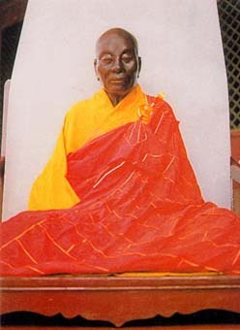
3. Common Attributes of Chinese Buddhist Sects:
3:1. Three Chinese sects of Buddhism:
1) Tian Tai 天台 (Heavenly Terrace)
2) Hua Yan 華嚴 (Flowery Splendor)
3) Chan or Zen 禪
The Sixth Patriarch

Slide 28
3:2 Attributes:
1) Affirmation of the subjectivity:
2) All baptized in Chinese philosophical
traditions, esp.
a) the concept of freedom in moral sense
b) the concept of dynamism in moral sense
Explain ?
a) freedom
b) dynamism

Slide 29
4.The Hua Yan Buddhism:
4:1 Sutra: 大方廣佛華嚴經 Hua Yan jing
(Flowery Splendor Scripture)
Fazang (法藏,643-712) or Law Mater
Xianshou 賢首法師

Slide 30
4:2 法界觀 (the universal Causation of the Realm of Dharmas = elements of existence)
四法界:
1). The Realm of Facts 事法界
2). The Realm of Principle Orders 理法界
3). The Realm of Principle and Facts
Harmonized 理事無礙法界
4). Realm of All Facts Interwoven and
Mutually Identified 事事無礙法界
∴ "One includes all, all includes one."
(一攝一切，一切攝一)

Slide 31
The world is visualized by Fazang as a tightly-interwoven and inter-penetrated network in which all dimensions of existence are mutually inclusive. (「因陀羅網，重重無盡」)
All phenomena are manifestations of mind.

Slide 32
4:3 The Theory of the Ten Mysterious Gates
(十玄門):
Empress Wu (武則天, 624?-705, r. 690-705)
Fazang, Treatise on the Golden Lion
Gold ←→ Lion
① Gold and Lion come into existence simultaneously.
② The ears and eyes of the lion penetrate with each
other.
③ Gold and lion are mutually inclusive. The "one"
and the "many" are mutually inclusive.
④ At the moment when we see the lion come into
existence, it is only gold that comes into existence.

Slide 33
⑤ When we look at lion, it is only lion, no gold; if we
see the gold, there is only gold, no lion. If we see
both, both are apparent.
⑥ Gold and the lion compliments with each other .
⑦ See the eyes, ears and other organs of the lion
comprise one lion. (inter-penetration region 因陀羅
網境界)
⑧ Lion —— non-existence
Gold —— reality
⑨ Lion is kharmas in which instance of thought arises
and perishes. Each instance of thought comprises the
Three Nature三時: past, present and future.
⑩ Neither gold nor Lion have their own autonomy.

Slide 34
4:4 Perfect harmony of the Six Characters 六相圓融
① Universality 總
② Specialty 別
③ Similarity 同
④ Difference 異
⑤ Integration 成
⑥ Disintegration 壞
∴ Each Dharmas becomes meaningful only in the
"realm."
∴ Mutual dependency of phenomena
The part and the whole are mutually dependent with
each other.

Slide 35
II.
Assignments:

Slide 36
．Chan, Chapter 25, pp. 406-424
．陳榮捷，下冊，廿五章，頁529-544
．勞思光，第二冊，第三章（肆），
頁314-329

Slide 37
III.
Discussion Questions:

Slide 38
1. Discuss the Zeitgeist of the Tang which is
accountable for its tremendous vitality.
*2. Discuss the common denominators of Chinese
Buddhism.

Slide 39
IV. 討論問題

Slide 40
法藏在《金獅子章》中，如何論證 「一即一切，一切即一」？這種論證程序，潛藏何種特殊的思維方式？
《金獅子章》中所呈現的思維方式與論證方法，與傳統中國的思維方式有何異同？（參讀：楊儒賓、黃俊傑編：《中國古代思維方式探索》，正中書局，1996）。

Slide 41
試以《金獅子章》為基礎，論述華嚴哲學要義，並聚焦於下列命題：
法界緣起
一乘圓教
因陀羅網境界
六相圓融
「心」在華嚴哲學中之地位如何？華嚴哲學中之心學，與儒家（尤其是孟子學）之心學有何異同？

Slide 42
V. 延伸閱讀

Slide 43
法藏著，方立天校釋：《華嚴金師子章校釋》（北京：中華書局，1983）。

Slide 44
Keywords:
“inter-penetration region” (因陀羅網境界)
“Perfect harmony of the Six Characters” (六相圓融)

